Slide 1
AI-Based Skin Cancer Detection Using Deep Learning and Ensemble Models
Mentor : Mr. Rizha Ur Rahman
Team members:
Yasinraj T (311822243030)
Mohamed Thahir M (311822243301)
Varshini M (311822243701)

Slide 2
Abstract
Skin cancer is one of the most commonly occurring cancers worldwide, and early detection plays a critical role in improving patient survival rates. Traditional diagnostic approaches such as dermoscopic examination and biopsy are time-consuming, costly, and highly dependent on specialist expertise. In this project, we developed a robust artificial intelligence-based classification system that automatically detects and categorizes skin lesions using deep learning. We evaluated several pre-trained convolutional neural network architectures and finally constructed a weighted ensemble model that combines the strengths of DenseNet201 and InceptionV3. The system was deployed using a Gradio-based web interface to provide real-time predictions and assist dermatologists in clinical decision-making.

Slide 3
Introduction
Skin cancer occurs due to abnormal growth of skin cells, primarily caused by excessive exposure to ultraviolet radiation. Among the different types, melanoma is the most aggressive and potentially fatal if not diagnosed early. Dermatologists commonly use dermoscopy to examine pigmented lesions; however, accurate interpretation requires significant training and experience. The rapid advancement of deep learning, particularly convolutional neural networks, has revolutionized computer vision by enabling machines to automatically extract complex visual patterns from medical images. This advancement provides a strong foundation for developing AI-assisted diagnostic systems in dermatology.

Slide 4
Problem Statement
The main problem addressed in this project is the development of an automated deep learning system capable of classifying dermoscopic skin images into seven distinct categories while handling significant class imbalance and visual similarity between lesion types. The system must achieve high predictive accuracy, maintain strong recall for malignant cases, and be deployable in real-time environments for clinical assistance.

Slide 5
Objectives
Data Preparation: To preprocess and augment the HAM10000 dataset to ensure model robustness against variations in lesion size, orientation, and lighting.
Baseline Establishment: To build and train a custom CNN from scratch as a performance benchmark.
Transfer Learning: To implement and evaluate state-of-the-art pre-trained architectures (ResNet50, DenseNet201, InceptionV3, etc.) using feature extraction and fine-tuning strategies.
Ensemble Optimization: To develop a weighted ensemble model that leverages the complementary strengths of the best-performing individual networks.
Deployment: To construct a user-friendly, modern web application for real-time lesion analysis.

Slide 6
Dataset Description
This project utilizes the HAM10000 dataset obtained from the ISIC Archive. The dataset contains approximately 10,000 dermoscopic images categorized into seven different lesion types, including both benign and malignant conditions. A major challenge associated with this dataset is class imbalance, as the majority of images belong to melanocytic nevi, while certain malignant and rare categories have significantly fewer samples. This imbalance makes accurate classification more challenging and requires special handling through augmentation and model optimization techniques.

Slide 7
Methodology
Data Preprocessing
Raw images require standardization before being fed into neural networks.
Image Resizing: Images were resized from their native resolution to $256 \times 192$ pixels using LANCZOS resampling to match the input requirements of the transfer learning models while preserving spatial features.
Normalization: Pixel intensity values were scaled from the standard $[0, 255]$ range to
$[0, 1]$ to ensure stable gradient descent.
$$X_{norm} = \frac{X}{255.0}$$

Slide 8
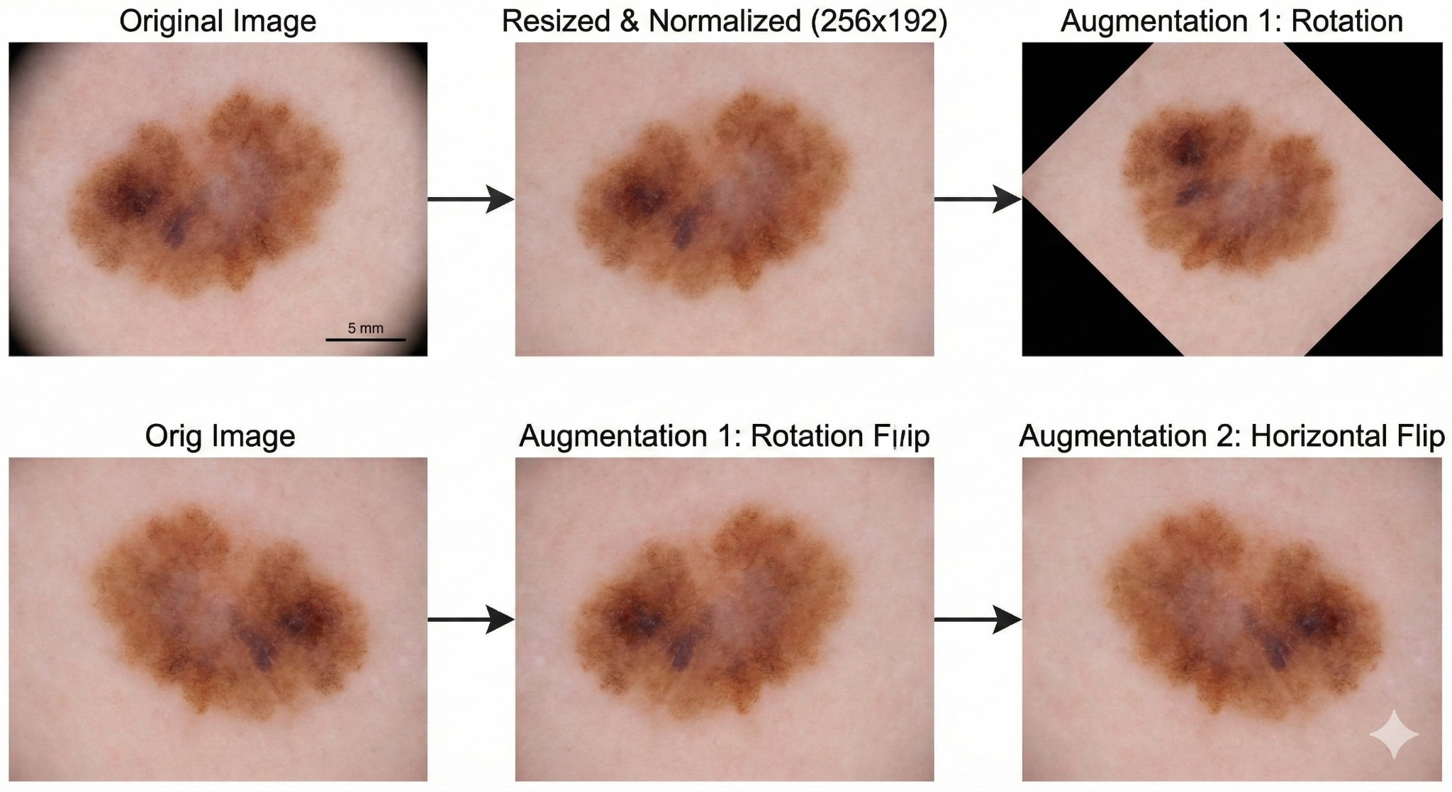
Data Augmentation: To combat the class imbalance and prevent overfitting, real-time data augmentation was applied using ImageDataGenerator. Transformations included:
Rotation ($40^\circ$ to $60^\circ$)
Width and Height Shifts ($20\%$)
Shear and Zoom ($20\%$) , Horizontal Flipping

Slide 9
Convolutional Neural Networks
Convolutional neural networks form the backbone of this project. A CNN processes an image through multiple layers, starting with convolution layers that extract spatial features such as edges, textures, and shapes. These features pass through a Rectified Linear Unit activation function, which introduces non-linearity into the model. Pooling layers reduce spatial dimensions while preserving important information, thereby decreasing computational complexity. Finally, fully connected layers generate probability distributions across the seven lesion categories using the soft max function.

Slide 10
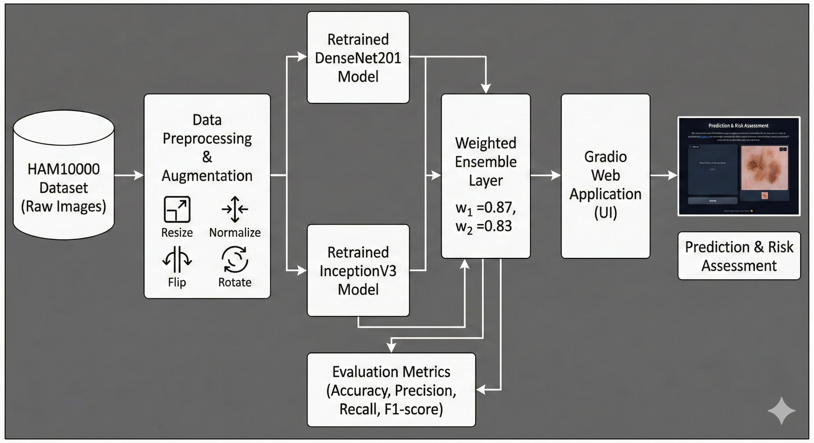
System Architecture
Model Training Pipeline

Slide 11
Evaluation Metrics Explained
To ensure medical reliability, raw accuracy is insufficient due to class imbalance.
Precision: The proportion of positive identifications that were actually correct. High precision means fewer false alarms.
$$Precision = \frac{TP}{TP + FP}$$
Recall (Sensitivity): The proportion ofi actual positives correctly identified. In cancer detection, high recall is vital to ensure no malignant lesions are missed.
$$Recall = \frac{TP}{TP + FN}$$
F1-Score: The harmonic mean of Precision and Recall, providing a single metric for imbalanced classes.
$$F1 = 2 \times \frac{Precision \times Recall}{Precision + Recall}$$

Slide 12
Advantages
High Generalization: The ensemble approach effectively mitigates overfitting, leading to robust performance on unseen test data.
Clinical Utility: By providing both a specific diagnosis and a binary risk assessment, it directly aids clinician workflows.
Scalability: The architecture is designed to easily integrate into existing telemedicine infrastructure or mobile backends
Limitations
Dataset Bias: The inherent imbalance in the HAM10000 dataset (majority nv cases) means the model may exhibit slightly lower recall on rarer classes (like df or vasc).
Black Box Nature: Like most deep learning models, the lack of visual explainability (e.g., heatmaps showing where the model is looking) can hinder total clinical trust.
Hardware Dependency: The ensemble model requires significant computational power (GPU) for rapid inference

Slide 13
Literature Review
CNNs for Medical Imaging: Convolutional Neural Networks have become the de facto standard for medical image analysis due to their spatial invariance and ability to learn hierarchical feature representations directly from raw pixels.
Transfer Learning in Healthcare: Medical datasets are often small and difficult to curate. Transfer learning mitigates this by utilizing models pre-trained on large-scale datasets (e.g., ImageNet). Studies show that transferring learned weights significantly reduces training time and prevents overfitting in medical domains.
Ensemble Methods in Deep Learning: Ensemble learning combines predictions from multiple models to reduce variance and bias. In medical imaging, averaging the soft max probabilities of architecturally diverse models (e.g., DenseNet's feature reuse combined with Inception's multi-scale processing) consistently yields superior generalization compared to single models.

Slide 14
Conclusion
This project successfully establishes a sophisticated, end-to-end machine learning pipeline for skin cancer detection. By progressing from baseline architectures to heavily customized, retrained transfer learning networks, the project proves the efficacy of deep learning in dermatological diagnostics. The final weighted ensemble model balances the
feature-extraction strengths of DenseNet201 and InceptionV3, achieving highly competitive accuracy metrics. Paired with a modern web interface, this system stands as a comprehensive, deployable prototype that fulfills the criteria for advanced clinical decision support and telemedicine integration.

Slide 15
References
Tschandl, P., Rosendahl, C., & Kittler, H. (2018). "The HAM10000 dataset, a large collection of multi-source dermatoscopic images of common pigmented skin lesions." Scientific Data, 5, 180161.
He, K., Zhang, X., Ren, S., & Sun, J. (2016). "Deep Residual Learning for Image Recognition."
Proceedings of the IEEE conference on computer vision and pattern recognition (pp. 770-778).

